Slide 1
Best Result Original Antenna

Slide 2


Slide 3
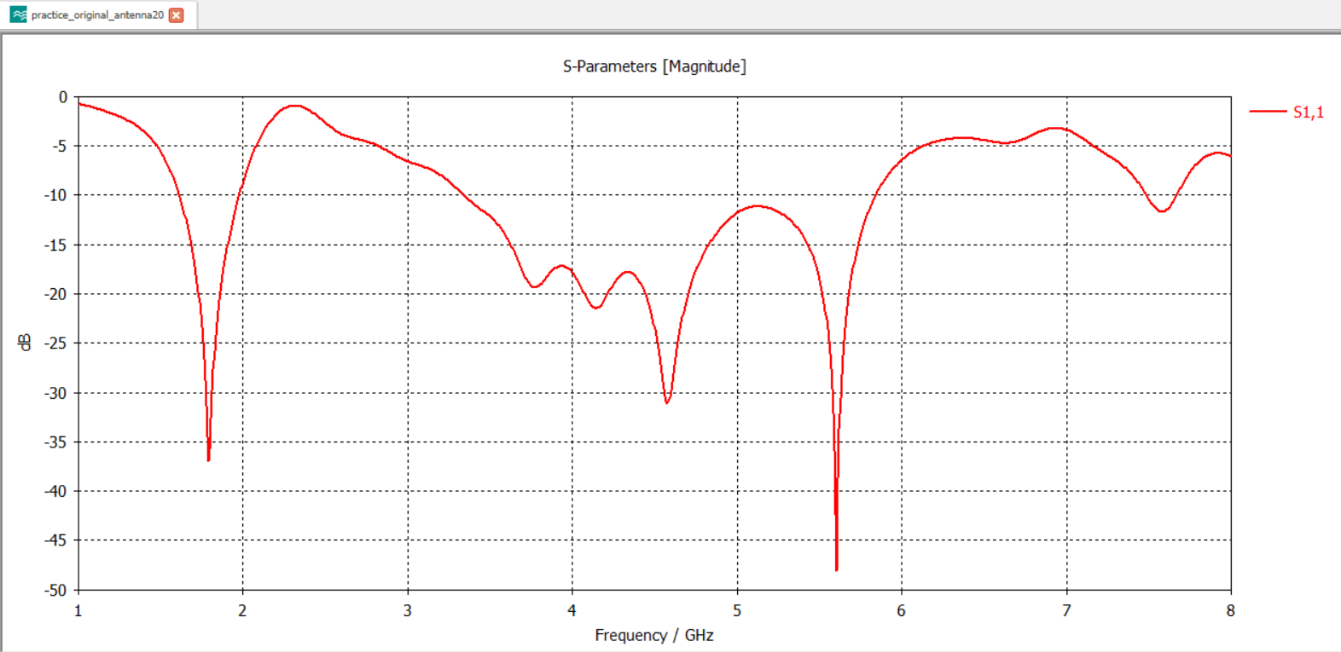
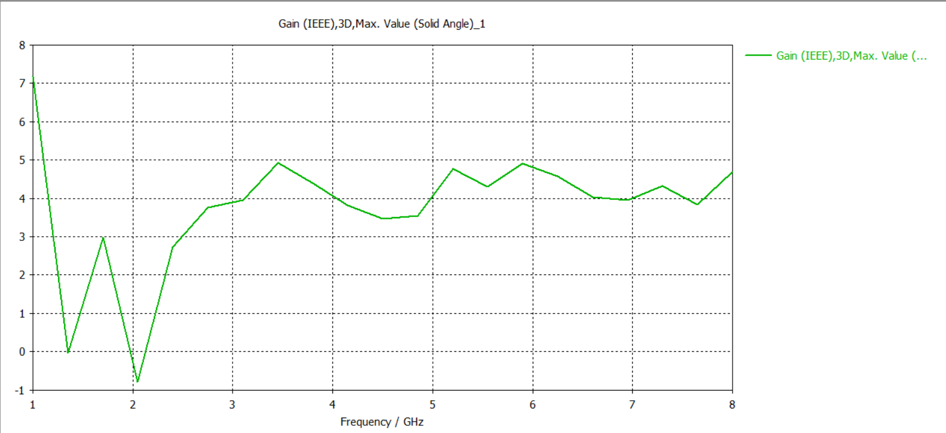

Slide 4
